Slide 1


CSE212 - Discrete Mathematics
GRAPH ISOMORPHISM
Presented to
Mr. Dewan Mamun Raza
Assistant Professor,
Department of Computer Science and Engineering
Daffodil International University

Slide 2
PRESENTER 1
SUPAN ROY
ID: 232-15-716

Slide 3
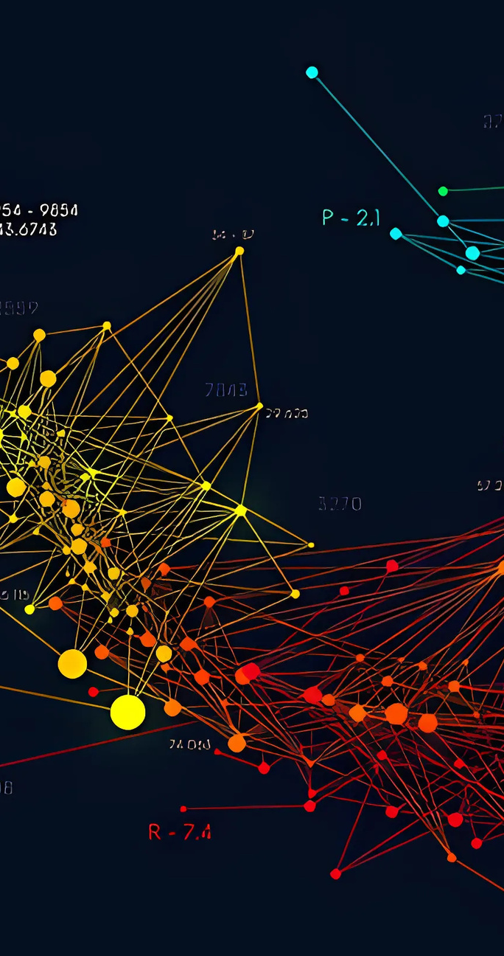
CONTENTS
01
What is Graph Isomorphism?
02
Properties of Isomorphic Graphs
03
Mathematical Example 1
04
Mathematical Example 2
05
Mathematical Example 3
06
Mathematical Example 4

Slide 4
OVERVIEW
What is Graph Isomorphism?
The simple graphs G₁ = (V₁, E₁) and G₂ = (V₂, E₂) are isomorphic if there exists a one-to-one and onto function f from V₁ to V₂ with the property that a and b are adjacent in G₁ if and only if f(a) and f(b) are adjacent in G₂, for all a and b in V₁. Such a function f is called an isomorphism.
Properties of Isomorphic Graphs
Same Number of Vertices and Edges
Same Degree of Vertices
Preserved Adjacency
Same Cycle Structure
Same Connectivity
Preserved Graph Type (e.g., complete, bipartite)

Slide 5
EXAMPLE 1
Are These Graphs Isomorphic?
a
b
s
t
e
f
w
x
Basic Comparison
d
c
v
u
G
H
G H
Number of vertices - 6 6
Number of Edges - 7 7
Total Number of degrees - 14 14
Number of 2 degree vertex - 4 4
Number of 3 degree vertex - 2 2
Number of cycles - 3 3

Slide 6
EXAMPLE 1
Are These Graphs Isomorphic?
a
b
s
t
One-to-one Mapping
f(a) = x
f(b) = t
f(c) = u
f(d) = v
f(e) = s
f(f) = w
e
f
w
x
d
c
v
u
G
H

Slide 7
EXAMPLE 1
Are These Graphs Isomorphic?
s
t
a
b
w
x
e
f
Adjacency Matrix for G and H
v
u
d
c
H
G
a b c d e f
x t u v s w
a
b
c
d
e
f
0 1 0 1 0 0
1 0 1 0 0 1
0 1 0 1 0 0
1 0 1 0 1 0
0 0 0 1 0 1
0 1 0 0 1 0
x
t
u
v
s
w
0 1 0 1 0 0
1 0 1 0 0 1
0 1 0 1 0 0
1 0 1 0 1 0
0 0 0 1 0 1
0 1 0 0 1 0
So, these graphs are Isomorphic

Slide 8
PRESENTER 2
MD. Shahinur Kabir Antor
ID: 232-15-159

Slide 9
EXAMPLE 2
Are These Graphs Isomorphic?
a
b
f
h
i
d
c
g
j
Basic Comparison
e
i ii
i
ii
Number of vertices - 5 5
Number of Edges - 6 6
Total Number of degrees - 12 12
Number of 2 degree vertex - 3 3
Number of 3 degree vertex - 2 2
Number of cycles - 3 3

Slide 10
EXAMPLE 2
Are These Graphs Isomorphic?
a
b
One-to-one Mapping
f
i
f(a) = h
f(b) = f
f(c) = g
f(d) = i
f(e) = j
h
d
c
g
j
e
i
ii

Slide 11
EXAMPLE 2
Are These Graphs Isomorphic?
a
b
f
Adjacency Matrix for i and ii
h
i
d
c
g
j
e
a b c d e
h f g i j
i
ii
a
b
c
d
e
0 1 1 1 0
h
f
g
i
j
0 1 1 1 0
1 0 1 0 0
1 0 1 0 0
1 1 0 0 1
1 1 0 0 1
1 0 0 0 1
1 0 0 0 1
0 0 1 1 0
0 0 1 1 0
So, these graphs are Isomorphic

Slide 12
PRESENTER 3
Pallab Debnath
ID: 232-15-676

Slide 13
EXAMPLE 3
Are These Graphs Isomorphic?
u₂
v₁
u₁
u₃
v₅
v₂
Basic Comparison
A B
Number of vertices - 5 5
Number of Edges - 6 6
Total number of degrees - 12 12
Number of 1 degree vertex - 0 1
Number of 2 degree vertex - 3 2
Number of 3 degree vertex - 2 1
Number of 4 degree vertex - 0 1
Number of cycles - 3 3
u₅
v₄
v₃
u₄
A
B
So, these graphs are not Isomorphic

Slide 14
PRESENTER 4
Umme Arifa Zaman Nirjhor
ID: 232-15-695

Slide 15
EXAMPLE 4
Are These Graphs Isomorphic?
u₁
u₂
v₁
v₂
u₃
v₃
Basic Comparison
v₅
u₅
u₄
G H
v₄
G
H
Number of vertices - 5 5
Number of Edges - 8 8
Total number of degrees - 16 16
Number of 2 degree vertex - 1 1
Number of 3 degree vertex - 2 2
Number of 4 degree vertex - 2 2
Number of cycles - 6 6

Slide 16
EXAMPLE 4
Are These Graphs Isomorphic?
u₁
u₂
v₁
v₂
One-to-one Mapping
f(u₁) = v₁
f(u₂) = v₃
f(u₃) = v₂
f(u₄) = v₅
f(u₅) = v₄
v₅
v₃
u₅
u₄
u₃
G
v₄
H

Slide 17
EXAMPLE 4
Are These Graphs Isomorphic?
v₁
v₂
u₁
u₂
Adjacency Matrix for G and H
v₅
v₃
u₅
u₄
u₃
v₄
H
G
u₁ u₂ u₃ u₄ u₅
v₁ v₃ v₂ v₅ v₄
u₁
u₂
u₃
u₄
u₅
0 1 0 1 1
v₁
v₃
v₂
v₅
v₄
0 1 0 1 1
1 0 1 1 1
1 0 1 1 1
0 1 0 1 0
0 1 0 1 0
1 1 1 0 1
1 1 1 0 1
1 1 0 1 0
1 1 0 1 0
So, these graphs are Isomorphic

Slide 18

THANK YOU
FOR YOUR ATTENTION
TEAM 4

